Slide 1
An Auditor’s Perspective: What PE Investors Should Know Audit Process, Valuations and Financial Statements
Jen Cuello
Tom Murdoch
Audit Partner, Financial Services
Audit Partner, Financial Services

Slide 2
Audit Process and Timeline
Planning
Interim
Fieldwork
Wrap up
Deliverables
-Understanding the entity (and LPA)
-Understanding key processes and controls (with walkthrough)
-Understanding IT (at Fund & 3rd parties)
-Risk Assessment
-Preliminary Analytics
-Substantive testing through Q3 (or latest interim date available)
-Investment purchases/sales, capital activity, subsequent closes , management fee calculations and new investors etc.
-Update interim areas through Q4
-Investment valuation procedures
-Capital allocation testing (including carried interest / clawback considerations)
-Financial statement review and support
-Conclude whether the financial statements are free of material misstatement and if there are any internal control issues
-Quality review
-Draft letters
-Financial Statements
-Governance Letter
-Management Letter

Slide 3
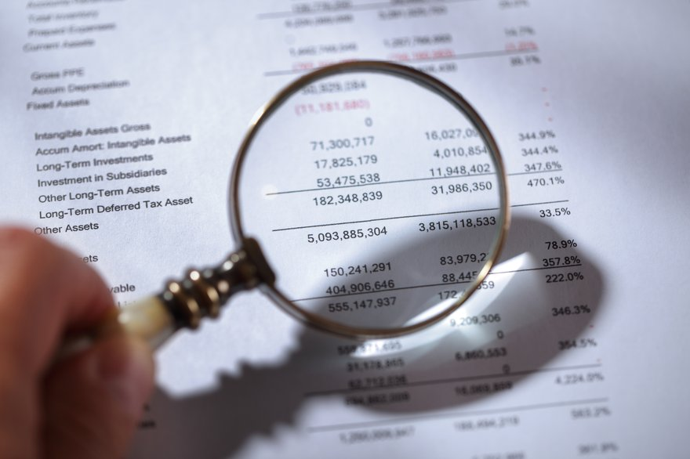
Financial Statements
Audit Report and Opinion
Valuation disclosures
General Partner/Limited Partner balance, carried interest
and capital disclosures
Management fees
Allowable Expenses
Commitments and Contingencies

Slide 4
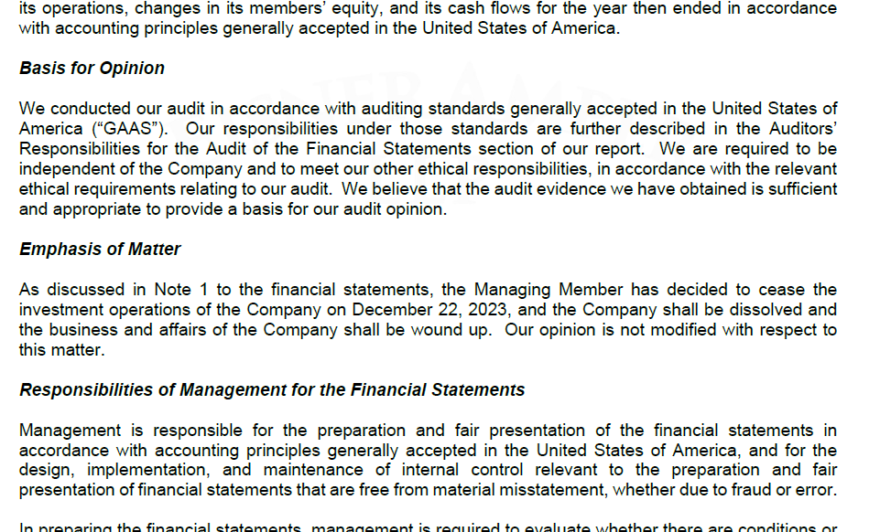
Audit Report and Opinion - Emphasis of Matter

Slide 5
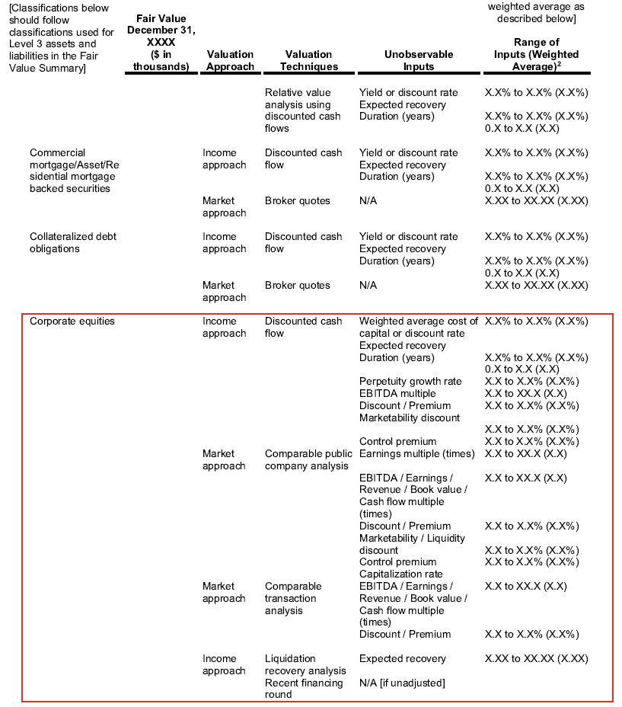
Valuation Disclosure – Unobservable Inputs

Slide 6
Commitments & Contingencies
NOTE X – Guarantees
The Partnership has obligations under certain guarantee arrangements. Guarantees are defined as contracts and indemnification agreements that contingently require a guarantor to make payments to the guaranteed party based on changes in an underlying (such as an interest or foreign exchange rate, security or commodity price, an index or the occurrence or on occurrence of a specified event) related to an asset, liability or equity security of a guaranteed party. Guarantees include contracts that contingently require the guarantor to make payments to the guaranteed party based on another entity's failure to perform under an agreement as well as indirect guarantees of the indebtedness of others. In the ordinary course of business, the Partnership enters into contracts that contain a variety of indemnifications.
The Partnership's maximum exposure under these arrangements is $XXXXX. On Month Day, Year, the Partnership entered into a pledge and security agreement (the "PSA") with XX Bank. The PSA requires that $XXXXX of cash held by the Partnership be used as pledged collateral to support two portfolio company guarantees in which the Partnership is guarantor. As of December 31, 20XX, the $XXXXX is held as restricted cash of which $XXX is for ABC, Inc. and $XXXXX is for XYZ, Inc.

Slide 7
Governance Letter – Required Communications
Our responsibility
Form and express an opinion on whether the financial statements are presented fairly in accordance with GAAP
Plan and perform audit to obtain reasonable assurance
Planned Scope and Timing
States whether there were any changes to the planned audit strategy, risks or timing of the audit.
Materiality
Auditor judgment, involving quantitative and qualitative considerations that are important to users of the FS
Misstatements are material if there is a substantial likelihood that they would influence a user of the FS
Management Specialists
Auditor Specialists
Primarily valuation related
Use of Specialists
Significant Policies, Estimates, Disclosures, Related Party Transactions
Transactions recognized in the proper period using appropriate accounting policies
Sensitive estimates and disclosures (valuation)
Significant unusual or related party transactions
Corrected and Uncorrected Misstatements
Uncorrected misstatements (must be below certain thresholds to have a clean opinion)
Corrected misstatements (can range from over trivial threshold to material corrected adjustments)
**May reference a Management Letter

Slide 8
Management Letter – Internal Control Communication
Consider internal control over financial reporting to design audit procedures to express an opinion
Not for the purpose of expressing an opinion on the effectiveness of internal control
Auditor Role
When the design or operation of a control does not allow management or employees, in the normal course of performing their assigned functions, to prevent or detect and correct misstatements on a timely basis.
Deficiency
Significant Deficiency
A deficiency, or a combination of deficiencies, in internal control that is less severe than a material weakness, yet important enough to merit attention by those charged with governance.
Material Weakness
A deficiency, or combination of deficiencies, in internal control, such that there is a reasonable possibility that a material misstatement of the Partnership’s financial statements will not be prevented, or detected and corrected on a timely basis
Example Deficiency:
Example Fund LP (the “Partnership”) did not have a sufficient compliment of controls designed and operating over the investment process to ensure the accuracy, completeness and valuation of the investment balances for the year ended December 31, 2023. The valuations did not have an appropriate level of reconciliation and review, resulting in incorrect balances recorded in the books and records that were provided to the audit team.
The Partnership must establish systems and procedures to ensure that investments are recorded timely and accurately, and to include proper level of review to ensure accuracy and completeness of investments from a cost and fair value perspective.

Slide 9
Valuation Policies and Considerations
Key components of a valuation policy
Important considerations not included in policies
What do auditors do when there is a disagreement in value or fund is not following valuation policy
Other findings/issues

Slide 10
Key Takeaways for Due Diligence Professionals
Ask about findings in governance and management letters
Ask about procedures to verify equity value once valuation of the Portfolio Company is determined
Ask about significant add backs to key metrics (revenue, EBITDA)
Review key provisions of the Limited Partnership Agreement (or equivalent) to ensure they are consistent with financial statement disclosures
If there were delays in the audit, ask for reasons why
Understand the caliber of firm rendering the opinion
Use key disclosures to better understand the position and future of the Fund

Slide 11
Questions?

Slide 12
Contact Information
Jen Cuello
Jennifer.Cuello@eisneramper.com
Tom Murdoch
Thomas.Murdoch@eisneramper.com

